Slide 1


CNN-BASED SUSPICIOUS ACTIVITY IDENTIFICATION
A Deep Learning Approach for Surveillance Systems
under the guidance of
Dr.SK.ALTHAF HUSSAIN BASHA M.Tech., Ph.D.
PROFESSOR
DEPARTMENT OF COMPUTER SCIENCE AND ENGINEERING
SHAIK YASEEN 21JU1A05J7
KATAKAM YASWANTH 21JU1A05J8
DEVANDLA VENKATESWARLU 22JU5A0505
THANNEERU VINAY 21JU1A05J2
KRISHNA CHAITANYA INSTITUTE OF TECHNOLOGY AND SCIENCES
(Approved by AICTE, New Delhi & Affiliated To JNTU, KAKINADA, Accredited by NAAC)

Slide 2


Introduction
Abstract
CNN-based system for real-time detection of suspicious activities
Targets behaviors like unauthorized access, loitering, and aggression
Trained on diverse video datasets to distinguish normal vs. suspicious actions
Achieves high detection accuracy with optimized CNN architecture
Handles varying lighting, camera angles, and environmental noise
Reduces manual monitoring effort and human-related errors
Scalable, adaptable solution for modern surveillance systems

Slide 3
Literature Survey
Traditional surveillance depends on manual human monitoring
Relies on basic motion detection and object tracking methods
Suffers from high false alarms and poor adaptability
Lacks ability to learn and detect new activity patterns
Deep learning, especially CNNs, transformed surveillance systems
CNNs automatically extract features from video data
CNNs enable real-time activity recognition and anomaly detection
Key CNN architectures used:
AlexNet – pioneered deep CNNs
VGGNet – deeper layers for better feature precision
ResNet – supports very deep networks without performance loss

Slide 4
EXISTING SYSTEM
⚠️ Drawbacks
High complexity and resource usage: CNNs need powerful hardware, limiting their use on edge devices or low-resource setups
Training data challenges: CNNs require large, well-labeled datasets
Gathering and annotating diverse suspicious activity data is time-consuming and difficult
Relies on manual observation and traditional computer vision techniques
Human operators monitor multiple camera feeds, leading to fatigue and oversight
Uses basic algorithms like motion detection and object tracking
Depends on predefined rules, making it inflexible for new or unexpected behaviors
Struggles with lighting changes, camera angles, and cluttered backgrounds
Results in high false positives and false negatives

Slide 5
PROPOSED SYSTEM
Uses CNNs for automated, real-time suspicious activity detection
Eliminates need for manual monitoring and basic rule-based methods
Detects behaviors like unauthorized access, loitering, and aggression
Trained on a rich dataset with both normal and suspicious activities
CNNs extract features from video frames to recognize complex behavior patterns
Adapts to challenging environments using advanced preprocessing
Handles lighting variations and different camera angles
Reduces false positives and false negatives significantly
Scalable and updatable with new data to tackle evolving threats

Slide 6
🌟 ADVANTAGES OF PROPOSED SYSTEM
Improved Accuracy Accurately detects a wide range of suspicious activities by learning complex patterns from video data.
Efficient Use of Resources Optimized CNN architecture ensures faster processing with reduced computational load.
Generalization to New Activities Capable of recognizing unfamiliar or evolving suspicious behaviors due to deep learning-based adaptability.

Slide 7
System Requirements
Hardware
Software
Operating system : Windows 7 Ultimate.
Coding Language : Python.
Front-End : Python.
Back-End : Django-ORM
Designing : Html, css, javascript.
Data Base : MySQL (WAMP Server).
Pentium IV Processor
4 GB RAM (min)
20 GB HDD
Standard Keyboard, Mouse, SVGA Monitor

Slide 8
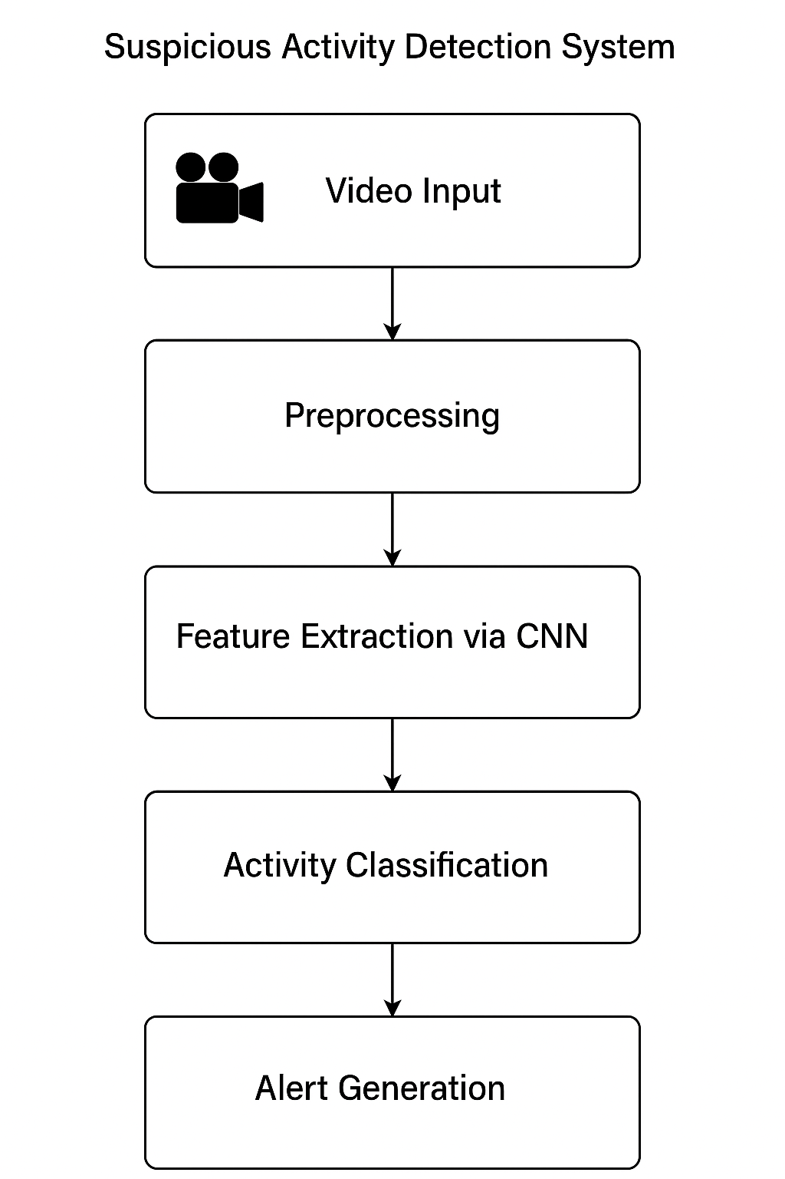

System Design – System Architecture
Video Input: Surveillance videos uploaded for analysis
Pre-processing: Frames extracted, resized, and normalized
Feature Extraction: CNN extracts key visual patterns from each frame
Activity Classification: Trained model classifies activities as normal or suspicious
Alert Generation: Alerts triggered for suspicious activity (e.g., fire, fight, theft)
Supports real-time, high-accuracy detection
Handles diverse environments and video quality

Slide 9
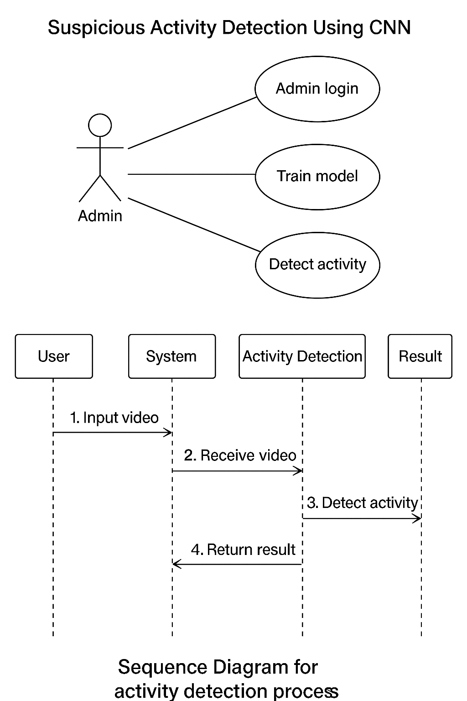
System Design – UML Diagrams

Slide 10
Implémentation Module 1: Admin Login
Provides secure access to the system for administrators
Admin authentication via username and password
Default credentials:
Username: admin
Password: admin
Redirects to admin dashboard upon successful login
Prevents unauthorized access to core functionalities like:
Training the model
Uploading and testing videos

Slide 11
Implementation Module 2: Video Upload
User-friendly interface for uploading surveillance videos
Allows selection of video files from local system
Supported formats: .mp4, .avi, .mov
Uploaded video is processed frame-by-frame
Prepares data for analysis by the CNN model
Enables real-time or batch detection of suspicious activity

Slide 12
Implementation Module 3: CNN Training
CNN model trained on labeled videos of suspicious activities
Activity classes include: Fight, Fire, Theft, Shooting, etc.
Dataset split:
80% for training
20% for testing
Model learns to extract spatial features from video frames
Achieved 99% accuracy on test dataset
Training initiated via “Train CNN Algorithm” option in admin panel

Slide 13
Implementation Module 4: Activity Detection
Initiated after model training is complete
Uploaded video is converted into individual frames
Each frame is passed through the trained CNN for analysis
Detection pipeline:
Frame extraction
Preprocessing
CNN prediction
Display of classification result on video
Detection continues until end of video or manual stop (q key)
Supports live feedback with visual alerts for detected threats
Designed to work with different video sources and qualities

Slide 14

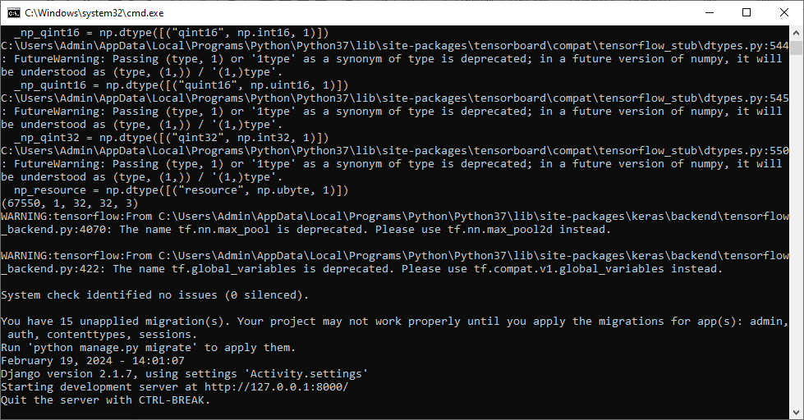
Testing and Validation
Results
Model Accuracy: Achieved 99% accuracy on test dataset
Evaluation Metrics:
Precision: High – few false positives
Recall: High – most suspicious events correctly detected
F1-Score: Balanced score reflecting strong model performance
Consistent results across different activity classes (Fight, Fire, etc.)
Detection performance remains robust under:
Varying lighting conditions
Different camera angles
Background noise and motion
Demonstrates model reliability for real-time applications
Dataset Source: Publicly available surveillance and activity videos
Training Video Folder includes labeled clips for each suspicious activity
Activity Classes Used:
Fight
Fire
Burglary
Shooting
Theft
Videos represent varied environments and angles for robustness
Model trained on 80% of data, tested on remaining 20%
Aim: Ensure system generalizes well across diverse scenarios
To run project double click on run.bat file to start web server

Slide 15
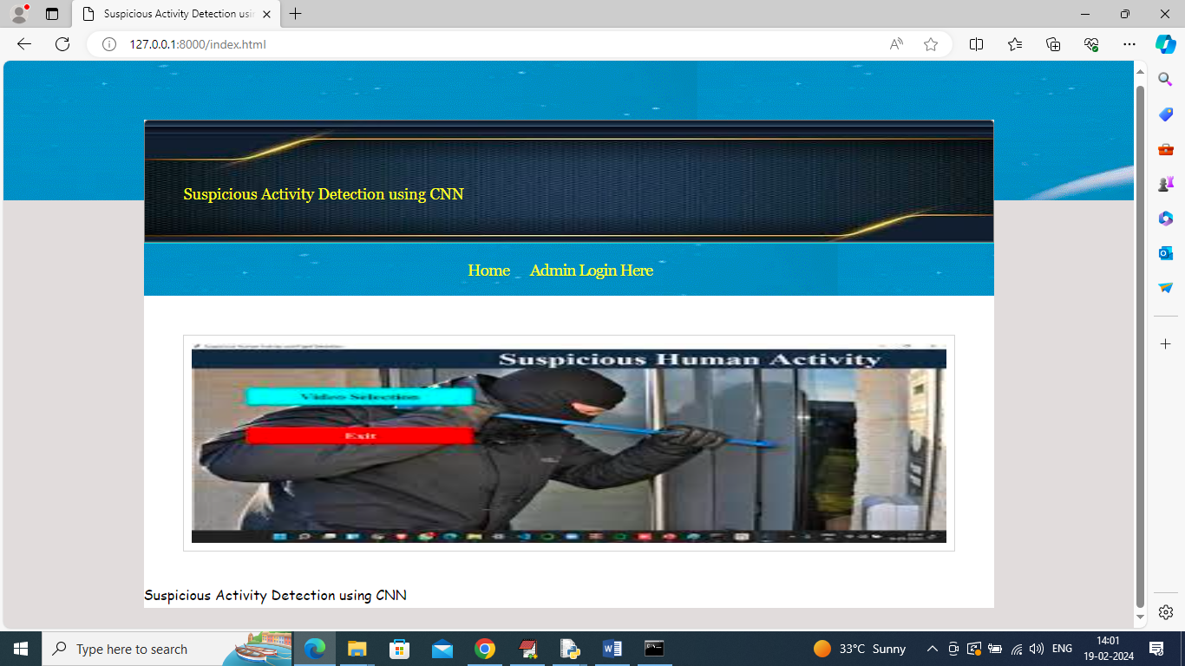

Slide 16
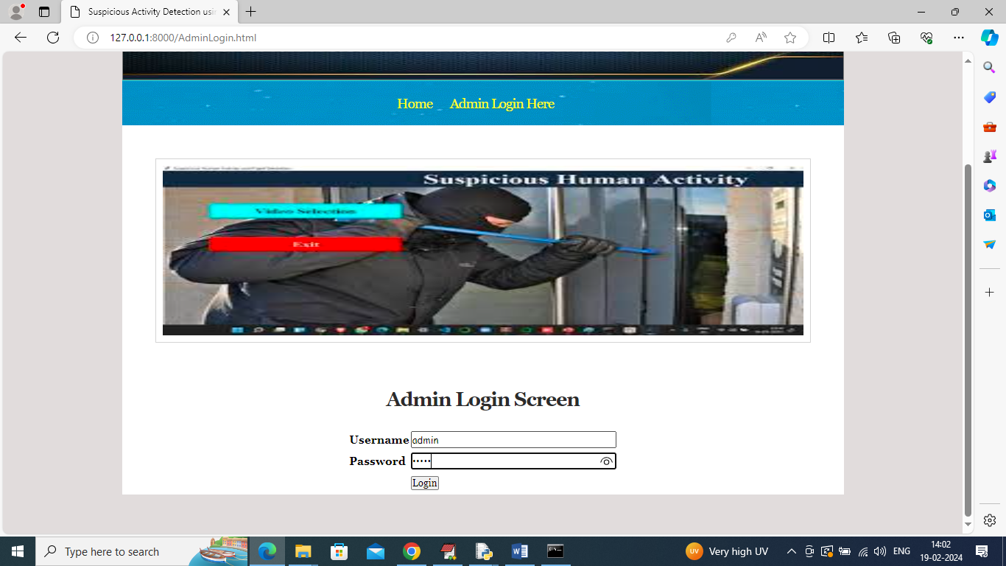

Slide 17
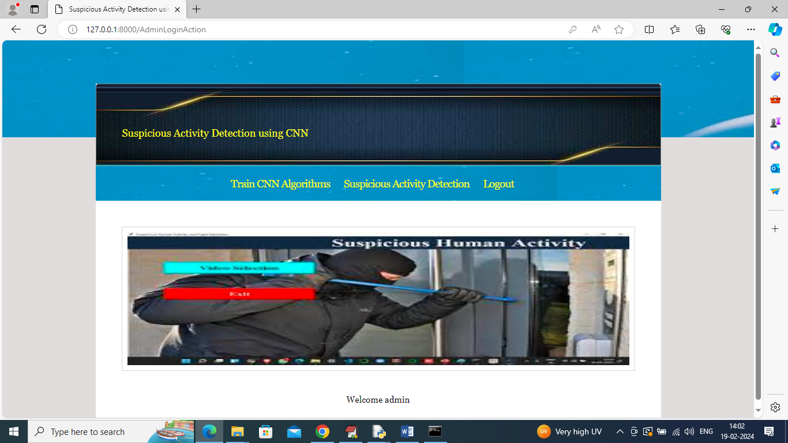

Slide 18
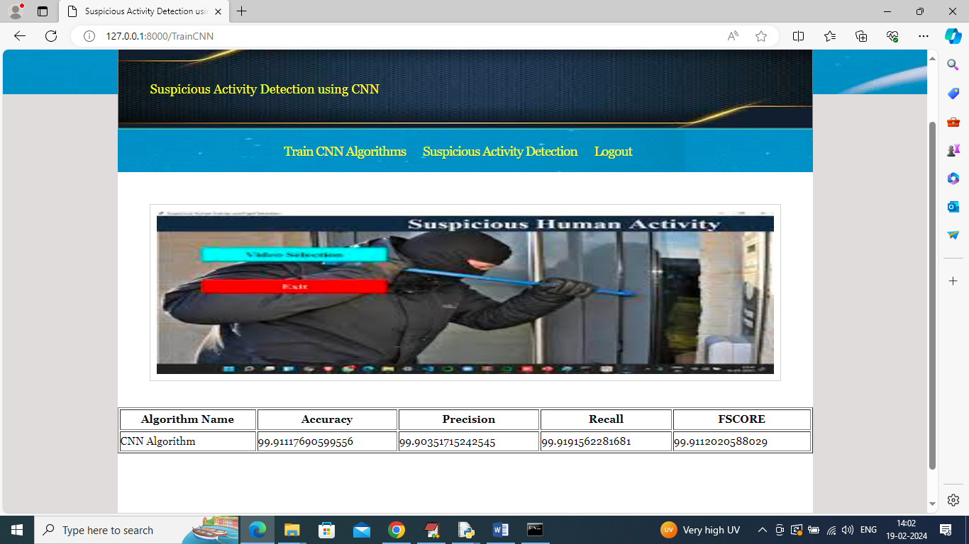

Slide 19
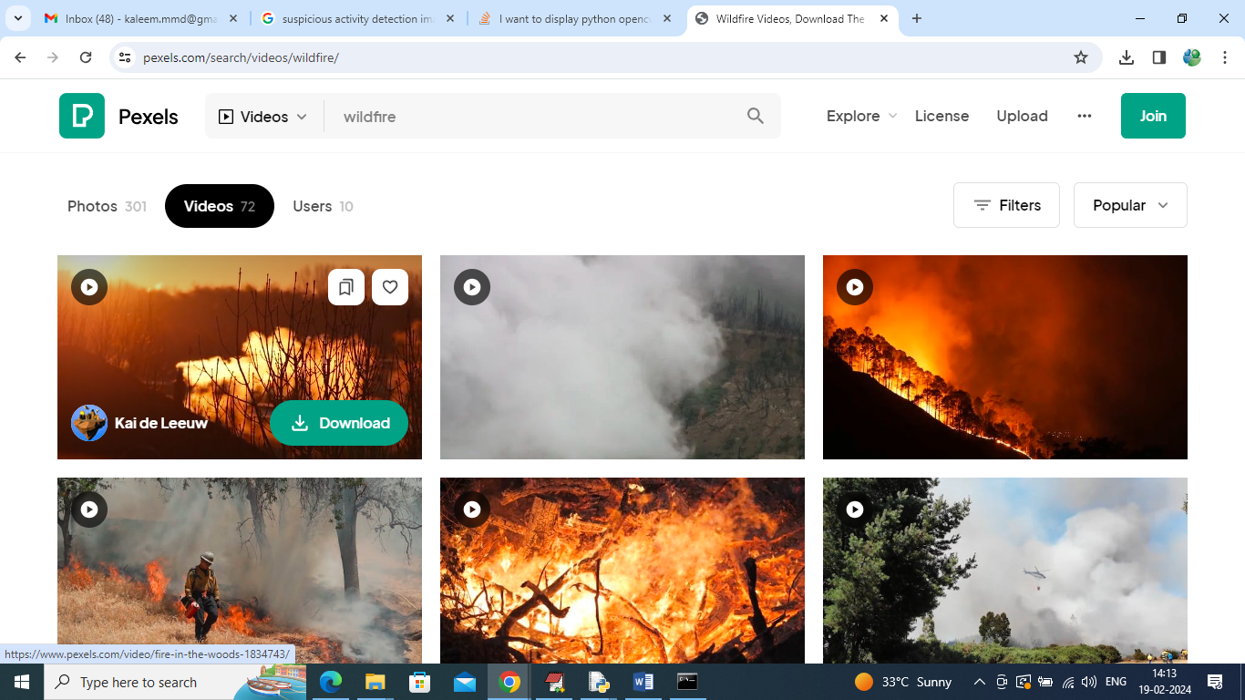
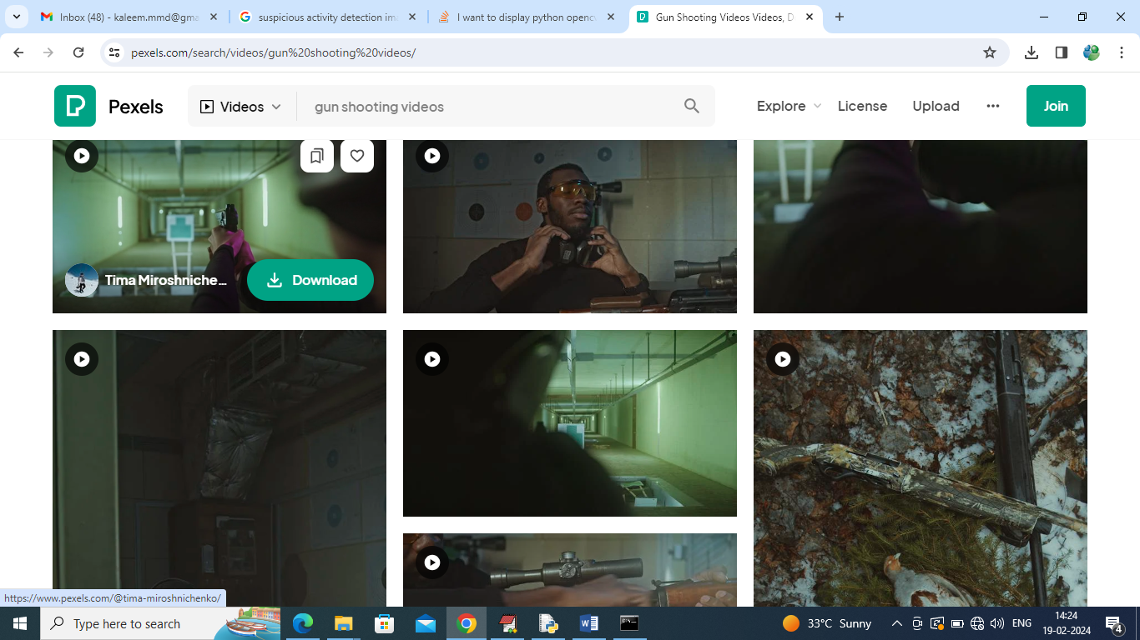
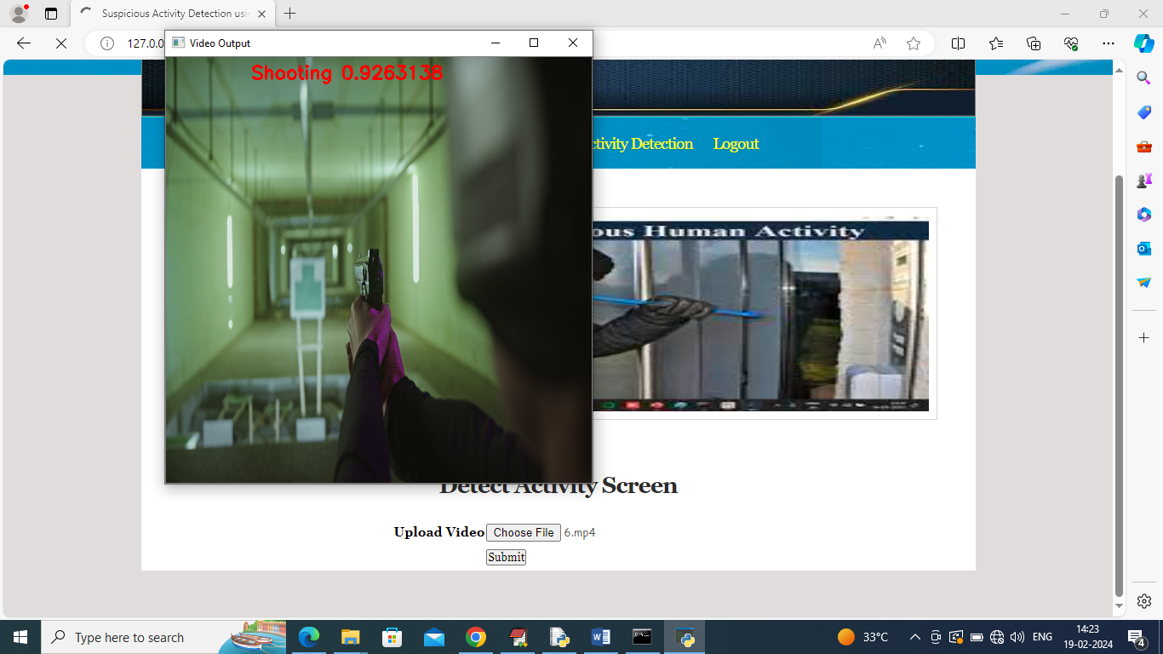
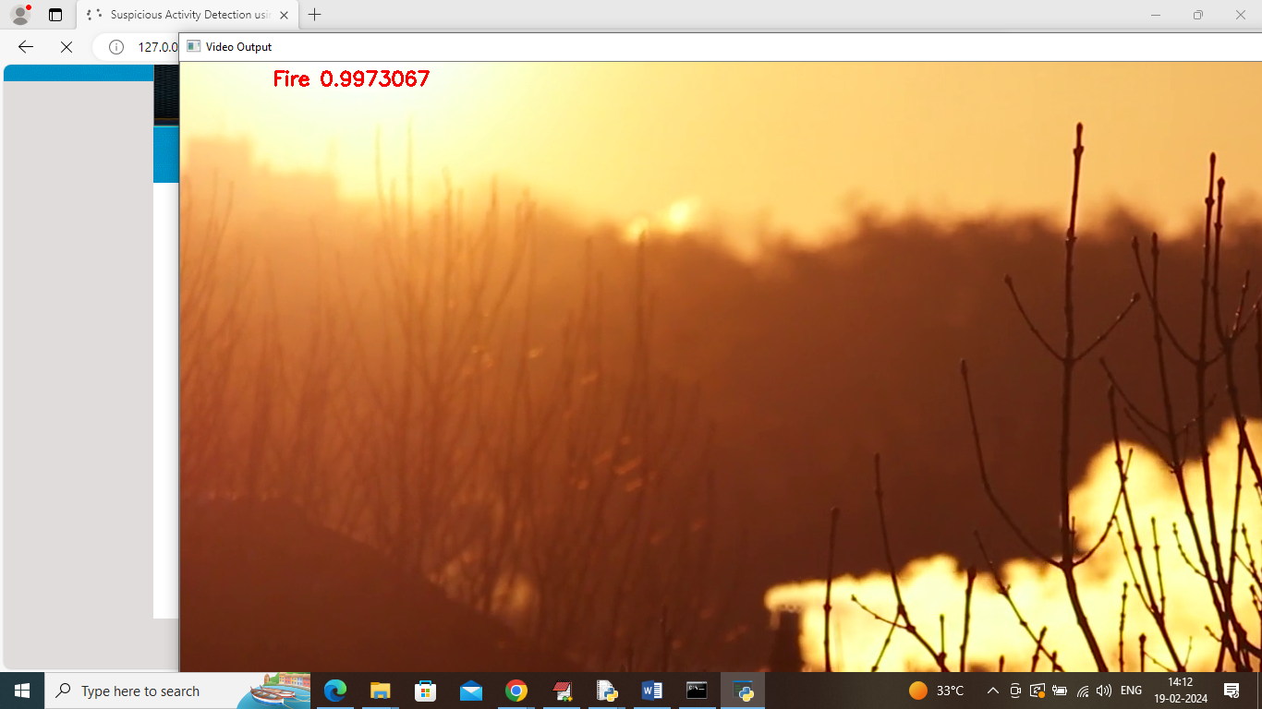
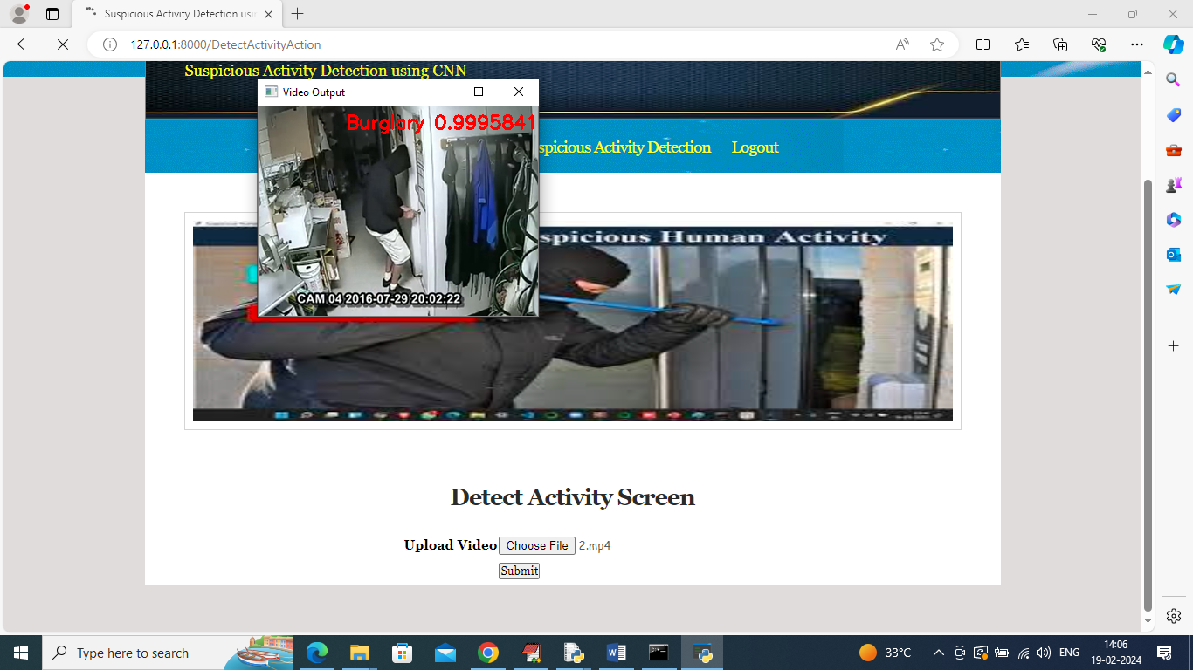
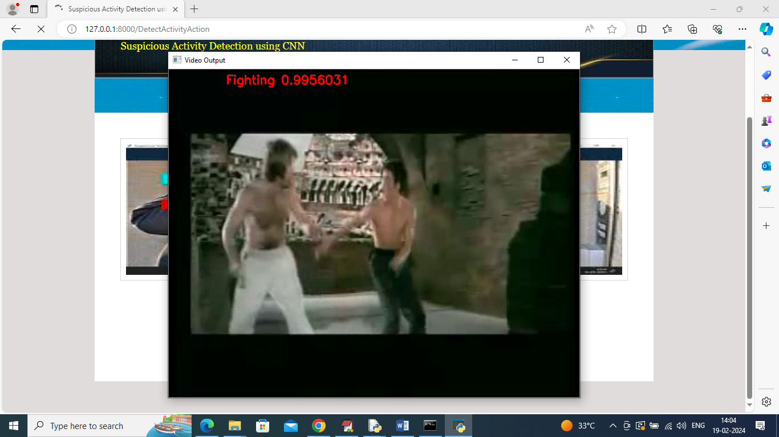
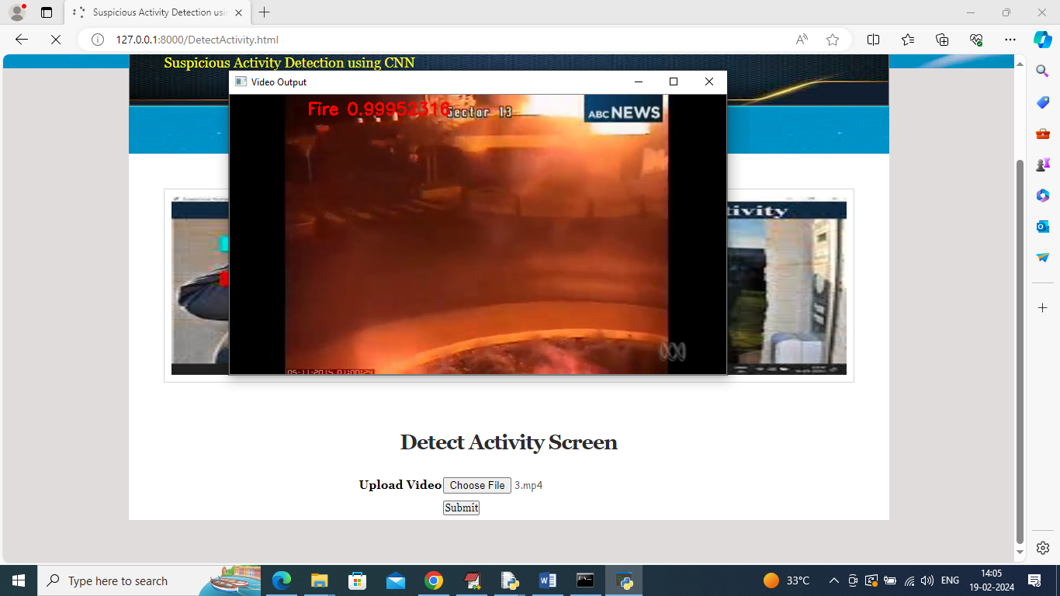
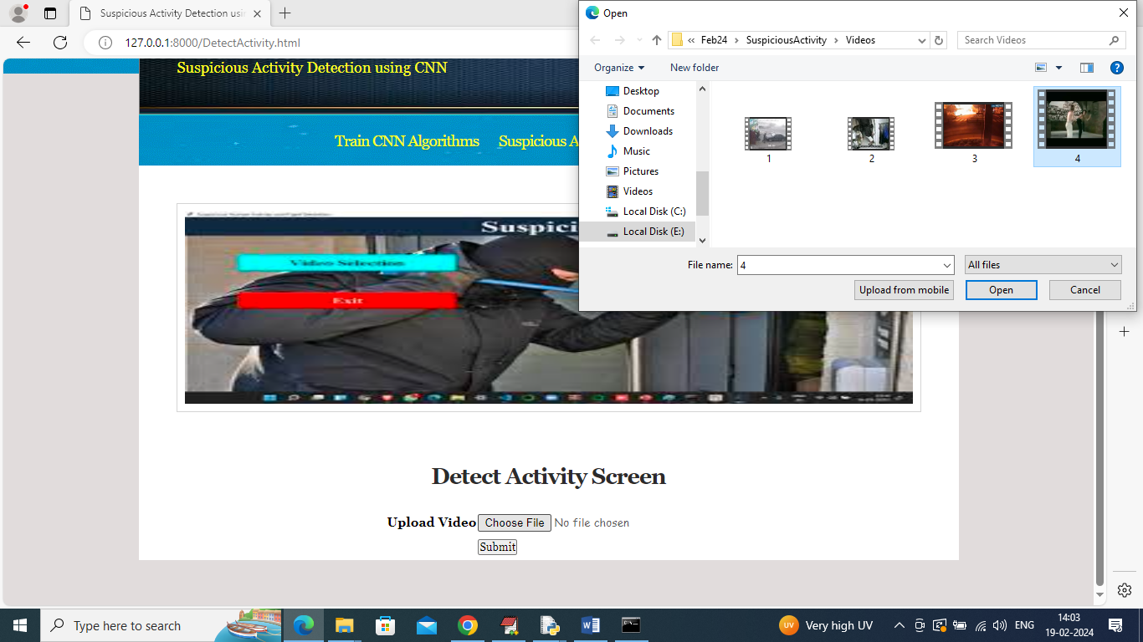

Slide 20
References
Conclusion
Future Scope
Krizhevsky et al. (2012) – ImageNet with CNNs
Simonyan & Zisserman (2014) – VGG Networks
He et al. (2016) – ResNet: Deep Residual Learning
Kang & Lee (2020) – CNN-based Surveillance Detection
LeCun et al. (2015) – Overview of Deep Learning
Develop lightweight CNN architectures for resource-constrained and edge devices
Enhance interpretability to better understand model decisions
Implement strategies to reduce bias and improve fairness in training datasets
Conduct real-world deployment trials for performance evaluation in live environments
CNNs show promising results in detecting suspicious activity in areas like surveillance, security, and fraud detection.
CNNs are good at learning spatial hierarchies, which is ideal for analyzing images and videos.
They can extract and learn complex patterns from video data, helping to identify suspicious behavior.
Automatic feature learning reduces the need for manual feature engineering.
Useful in dynamic environments, where suspicious activity patterns may vary.
THANK YOU✨

